Slide 1
S T U D E N T L E A R N I N G R E S O U R C E
Art
Creative Practice

Slide 2
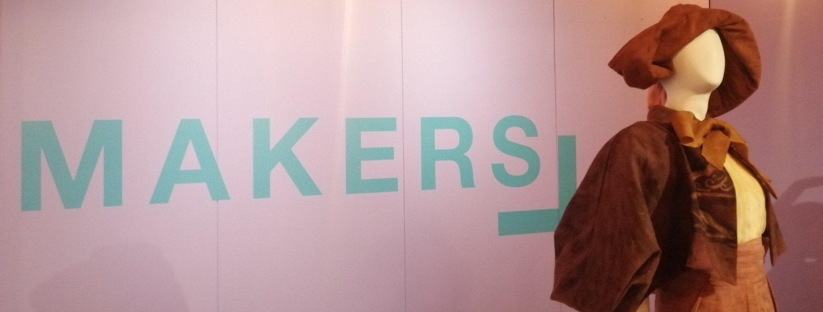
CONTENTS
We The Makers exhibition overview
Structural, Personal and Cultural Lens
Artist Case study: Jasmine-Skye Marinos
Artist Case study: Jedda Bahloo
Artist Case study: Emily Rastas
Artist Case study: Kate V M Sylvester
Further Resources and dates

Slide 3
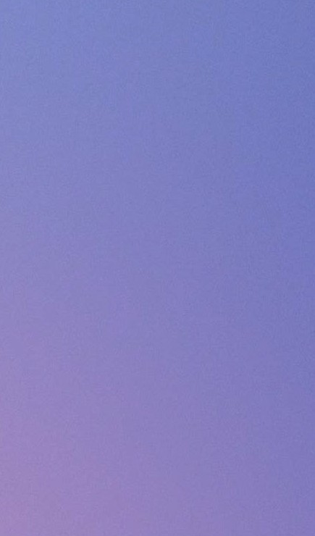
PREMISE OF
THE
COMPETITION
Both design competition and exhibition
Held every two years.
The exhibition, shown at the National Wool Museum, is aligned with Geelong’s designation as a UNESCO City of Design
Champions the future of design and Geelong’s ongoing role in the wool, fibre and textile industries.
The designer’s brief is to create one original outfit that “represents their personal design aesthetic and showcases their commitment to sustainable fashion.”
Aimed at emerging designers with less than ten years of industry experience centered around sustainable fibre and textiles. Open to designers worldwide.
Judged winner is awarded $10,000
People’s Choice Award receives $2000

Slide 4
EXHIBITION GOALS
In face of the fashion industry’s ‘throw out’ culture – encourage its young professionals to be its own solution
2023 WE THE MAKERS
Curator Josephine Rout shortlisted 20 entries from 77 designs. All shortlisted garments were part of the exhibition that opened on the 1st of June
Three judges selected final winner 35 Life by Canwen Zhao
The exhibition captures perspectives on what defines sustainable fashion; ethical practice, design ingenuity, material consciousness, circular process, design and business innovation

Slide 5
ARTIST CASE
STUDIES
Material Innovation Jasmine-Skye Marinos ‘Kaweerr Koorran Dress’
Design Innovation
Jedda Bahloo
‘mmm…must have missed it…’
Circular Process Innovation
Kate V M Sylvester
‘My Favourite t-shirt’
Business Innovation
Emily Rastas
‘Electric Avenue’
Shortlisted entries can be viewed on We the Makers website
The following slides focus on four designers who each typify one of competition’s key criteria areas

Slide 6
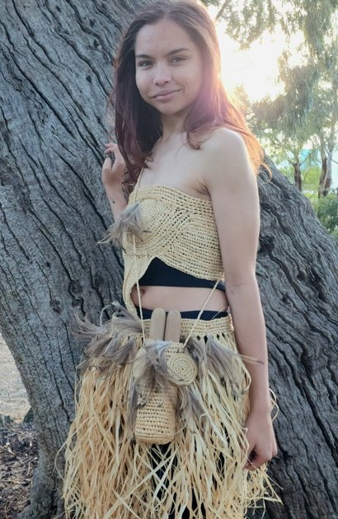
JASMINE-SKYE MARINOS
Artist:
Jasmine-Skye Marinos
Title:
Kaweerr Koorran Dress
Materials:
Raffia, Emu feathers,
Techniques:
Indigenous basket-weaving
Typifies:
Material innovation
Video Interview:
Learn | WE THE MAKERS
We The Makers Exhibition - Designers

Slide 7
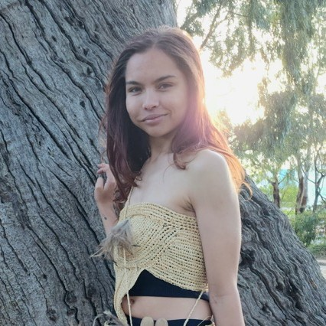
JASMINE-SKYE MARINOS
QUESTIONS
Have you tried using a natural fibre in your artwork?
Do you use any traditional techniques in your art practise?
Who taught you those skills?
STRUCTURAL
No modern machines were used in making the dress and accessories
Handwoven
Made from raffia which is a sustainable and biodegradable plant fibre
PERSONAL
Wanted to design an outfit using only traditional methods
CULTURAL
Proud Arrernte woman
Lived on Waddawurung country for over 10 years
Example of Indigenous basket-weaving as applied to fashion
Emu feather and grass skirts are used in Aboriginal celebrations and dance
Kaweerr Koorran Dress in Waddawurung language means Emu Feather Dress

Slide 8
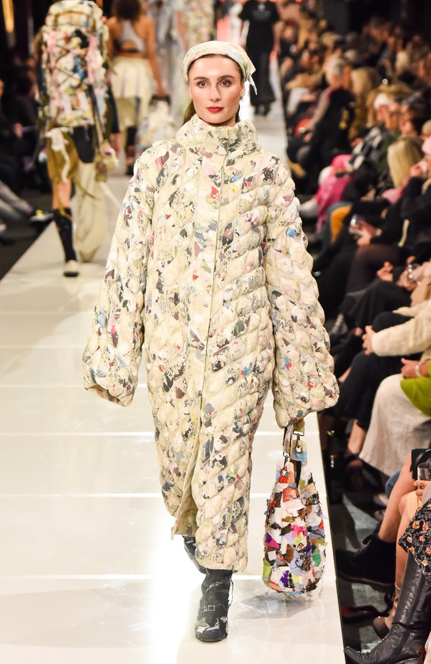
JEDDA BAHLOO
Artist:
Jedda Bahloo
Title:
mmm…must have missed it…
Typifies:
Design Innovation
Materials:
Recycled textile, thread
Web:
www.jeddabahloo.com/about
We The Makers Exhibition - Designers

Slide 9
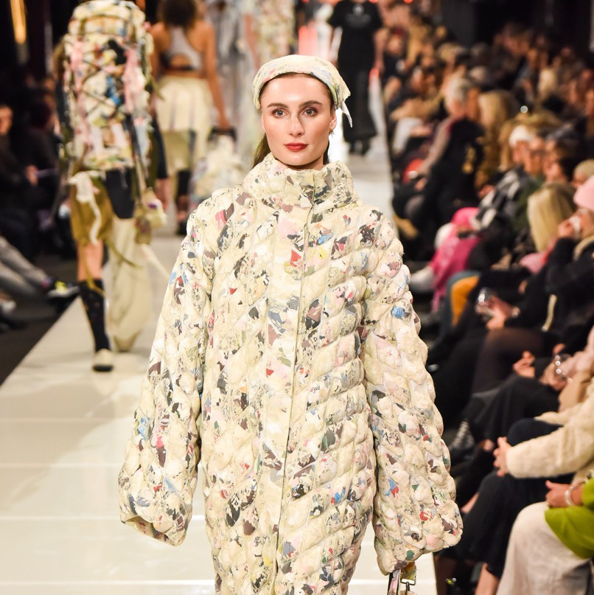
JEDDA BAHLOO
QUESTIONS
Does the way Bahloo’s structured her garment successfully communicate her critique of the fashion industry?
How would you design a jacket to comment on the world’s fast fashion trends?
STRUCTURAL
This sculptural quilted coat is wadded with multiple- coloured scraps, visible through the mesh of the lace top- layer
PERSONAL
Revealing that which is usually hidden, Jedda Bahloo’s work comments on the fashion system at large, and its contribution to environmental waste and the exploitation of human labour.
CULTURAL
Naarm-based multidisciplinary artist
Questions the capacity for the fashion industry to be truly sustainable
Incorporate elements of waste, modularity, functionality, emotional durability and mending within her work to critique how fashion (the entire industry & mode of production) impacts the world around us.

Slide 10
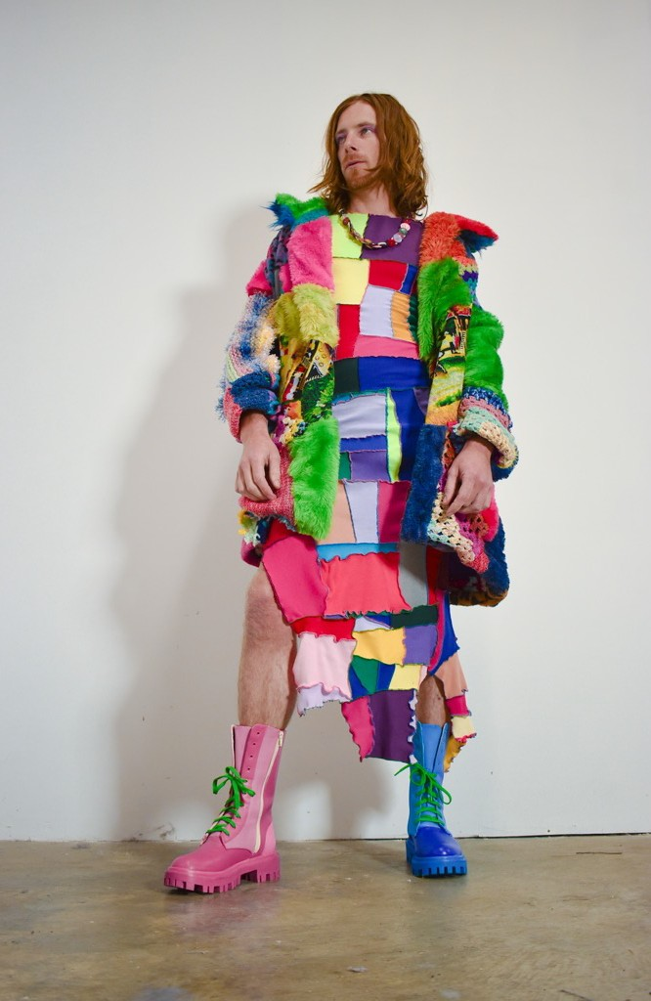
EMILY RASTAS
Artist:
Emily Rastas
Title:
Electric Avenue
Typifies:
Business Innovation
Materials:
Recycled crochet patches, recycled textiles
Video Interview:
Learn | WE THE MAKERS
We The Makers Exhibition - Designers https://emipelidesign.com/pages/about-emi

Slide 11
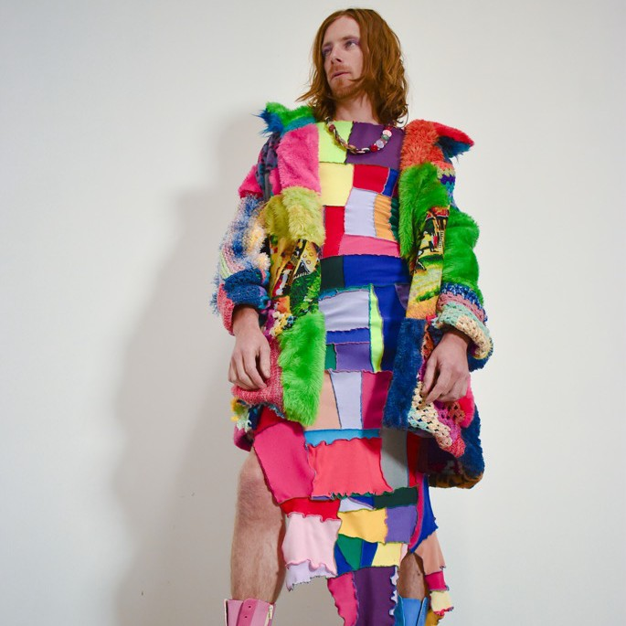
EMILY RASTAS
QUESTIONS
In what way do clothes reinforce gender stereotypes?
In what way does Rastas’ work push cultural sensitivities?
How does Rastas’ choice of materials and techniques subvert the fast fashion business model?
STRUCTURAL
Vibrant colours and clashing patterns is pivotal in work
PERSONAL
Belief that fashion should be fun, exciting and playful
Organises colour, texture and detail in a manner to stimulate dopamine in viewers brain
Repurpose existing materials that would otherwise end up in landfills, reducing waste and the environmental impact of her own production
Design is intentionally genderless, inclusive and multi size pieces. Challenges traditional fashion norms and encourage colourful self-expression without limitations
Salvaging even the smallest fabric pieces from her clothes manufacturing and uses scraps to re-assemble new works
CULTURAL
Statement about the current political climate. With a feminine look on a masculine figure and subtle gender role play in the shoes, this outfit pushes boundaries of our cultural understanding of gender

Slide 12
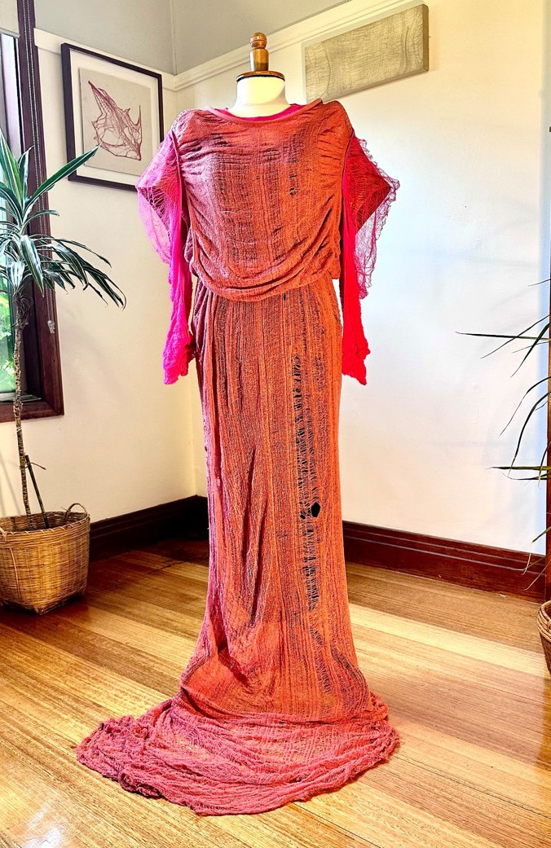
KATE V M
SYLVESTER
Artist:
Kate V M Sylvester
Title:
My Favourite t-shirt
Typifies:
Circular Process Innovation
Materials:
Recycled t.shirt
Video Interview:
Learn | WE THE MAKERS
We The Makers Exhibition - Designers http://www.katevmsylvester.com/

Slide 13
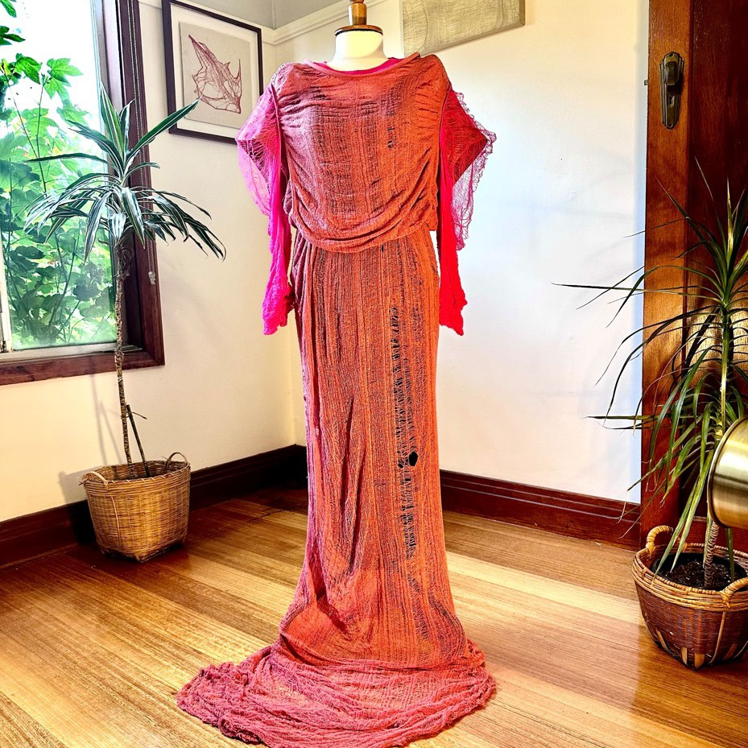
KATE V M
SYLVESTER
QUESTIONS
How has Sylvester use her techniques to redefine a fast fashion tshirt?
What message does the transformation of a mass produced tshirt to a unique couture garment communicate?
Does the techniques and repositioning of her work as a couture piece make you
reconsider buying a new tshirt?
STRUCTURAL
Meticulously de-threaded by hand over seventy hours, this gown is made from just two recycled and deconstructed
t-shirts reveal the construction of the material made into everyday shirts
PERSONAL
Each garment is hand stitched to reverse the time investment of a tshirt (fast fashion) into a couture wearable art (slow art)
To respect and celebrate the beauty and the potential of the fabric
Inspire a positive response, instead of consumer guilt, that is empowered by the beauty of the things we take for granted
CULTURAL
Transform mass produced clothing into slow art

Slide 14
RESOURCES AND
UPDATES
WE THE MAKERS WEBSITE
Where you find a full listing of designers, design description and images of their entries
CASE-STUDY ARTIST INTERVIEWS
Four artist content videos linked to curriculum focus areas found under ‘Learning’ tab of We The Makers website
WE THE MAKERS EDUCATOR BRIEFING
Join our Learning Officer Beth Holland and Senior Curator, Josephine Rout, for an overview of the exhibition, its’ related programs and online resource which aligns to VCE Art Creative Practice and VCE Art Making and Exhibiting areas of study.
AN INTRODUCTION TO WE THE MAKERS (TOUR)
This educator-led introduction to the exhibition will engage students in an examination of a choice of finalist’s ideas, influences, materials and techniques. Discussion points include using Interpretive lenses to analyse finalists’ ideas and perspectives. The materials, techniques, technologies and processes utilised by designers in the show will also be talked through
CREATIVE PRACTISE FORUM
In this half day forum students will meet and learn from a choice of finalists in We the Makers. Through Q&As and practical workshops, students will
gain insight into the finalist’s creative processes, research, their business model, experimentation, and realisation of the outfit on display.

Slide 15
DATES
WE THE MAKERS EDUCATOR BRIEFING
12 July 4-5pm Click here to book
AN INTRODUCTION TO WE THE MAKERS
Mon-Friday 11am, 1pm, 2pm Click here to book
CREATIVE PRACTISE FORUM
25th July 10am-1:30pm Click here to book
Click below to make your VOTE
Geelong UNESCO City of Design People’s Choice Award

