Slide 1
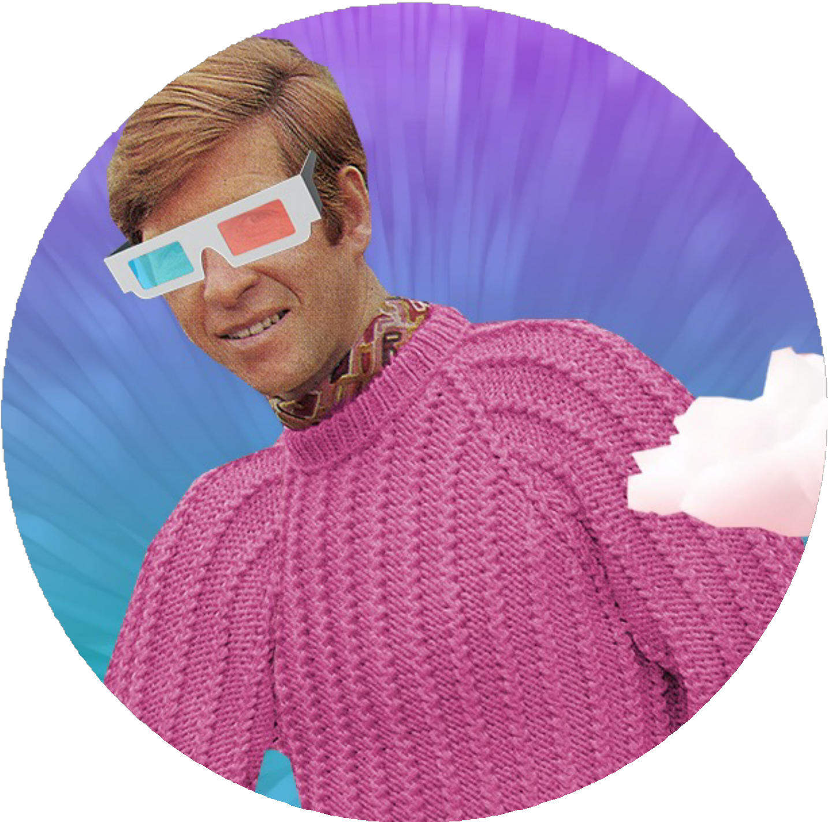
S T U D E N T L E A R N I N G R E S O U R C E
Art Making
and Exhibiting

Slide 2
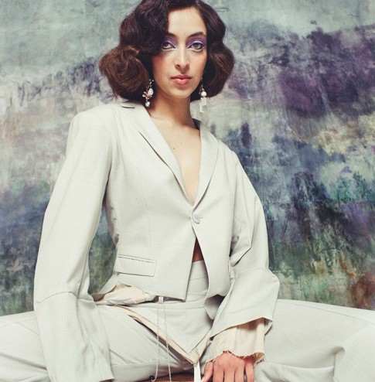
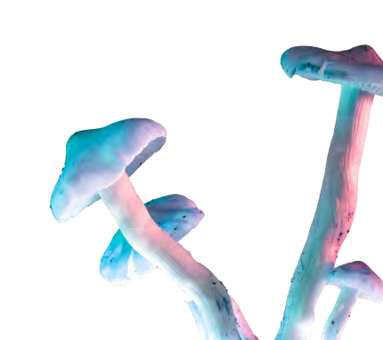
CONTENTS
National Wool Museum
We The Makers Exhibition
Exhibition Creation:
Exhibition Planning
Curating an Exhibition
Installing an Exhibition
Conservation
Resources and Dates

Slide 3
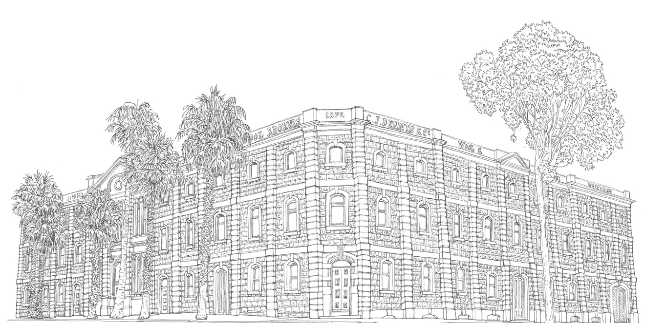
THE
NATIONAL WOOL
The National Wool Museum opened by Queen Elizabeth II in 1988.
Has permanent displays but also hosts travelling exhibitions and displays two bi-annual competitions:
We The Makers
Art Quilt
MUSEUM

Slide 4
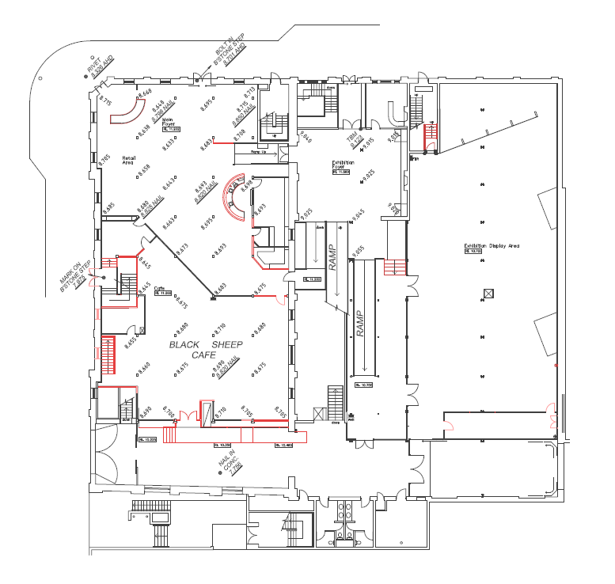
EXHIBITION CREATION: VENUE
National Wool Museum is located at the old Denny’s Lascelles building
Built in 1872
Heritage building formally a wool stockbroker building – where bales of wool were auctioned
Made from bluestone and brick
Building intrinsically tied to Geelong’s role as textile industry
ON–SITE FOCUS
Is this a fitting building to host a sustainability fashion competition?
How does approaching the building make you feel?

Slide 5
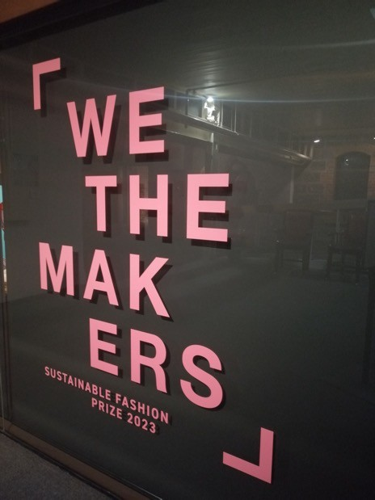
NATIONAL WOOL
MUSEUM TEAM
PROJECT
CONTRACTORS:
THE MUSEUM TEAM
Director
Curator
Public Programs manager
Administration Officer
Conservation staff
Arts and Heritage Collection Officer x2
Learning officer
Programs Assistant
Retail and Operations Manager
Visitor Services Officers (front desk)
Communications & Partnership Officer
Museum Technician
Loom Operator
Exhibition designer
Exhibition designer assistant
Design company
Photographer
Film company
Art Installer
Label and sign printers

Slide 6
WE THE MAKERS
COMPETITION AND
Both design competition and exhibition
Held every two years.
The exhibition, shown at the National Wool Museum, is aligned with Geelong’s designation as a UNESCO City of Design
Champions the future of design and Geelong’s ongoing role in the wool, fibre and textile industries.
The designer’s brief is to create one original outfit that “represents their personal design aesthetic and showcases their commitment to sustainable fashion.”
Aimed at emerging designers with less than ten years of industry experience centered around sustainable fiber and textiles.
Open to designers worldwide
Judged winner is awarded 10,000 dollars
People’s Choice Award receives
$2000
EXHIBITION

Slide 7
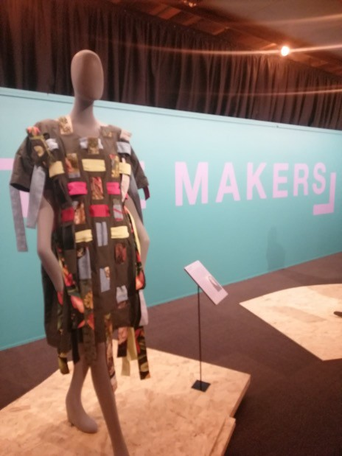
FOUR FOCUS AREAS
MATERIAL
INNOVATION
A new approach to using a material. A new blending of technique or materials
CIRCULAR PROCESS
INNOVATION
Demonstrates material consciousness and demonstrates the reuse of materials
Key criteria of accepted designs were they underpinned sustainable fashion:
Material Innovation
Design ingenuity
Circular process
Business innovation
Josephine Rout (NWM Head Curator) selected the top 20 designs
DESIGN
INNOVATION
Distinctive aesthetic and communicative style
BUSINESS
INNOVATION
A sustainable and ethical business approach

Slide 8
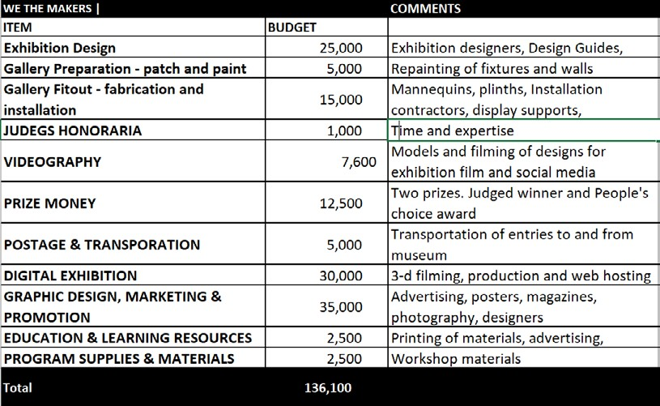
EXHIBITION
PREPARATION
BUDGET
To cover both the competition + exhibition components of We The Makers
A clear budget which includes leeway to cover unexpected demands
Covers all aspects of the exhibition: advertising to contractors
Solutions to budget restraints – Loan of mannequins from National Gallery of Victoria
Solution to budget restraints - Loan of installation art for gallery and foyer from ACMI

Slide 9
EXHIBITION
PREPARATION
PLANNING A SCHEDULE/PROGRAM/ EXHIBITION DESIGN
Exhibition schedule and deadlines set up
Initial objectives: coordination of website and advertising competition
Firm dates enabled resources to be committed
Challenge at this stage: Designs not able to be used in advertising or planning
Engagement of Design Company to create brand guide
= establishes the exhibition’s ‘look’

Slide 10
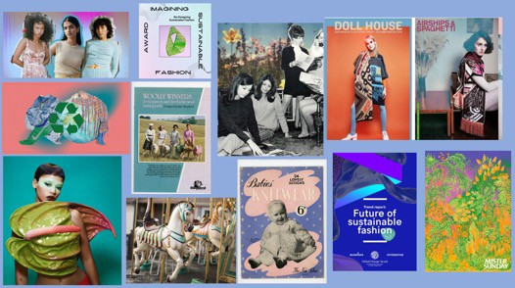
EXHIBITION
PREPARATION
Usually exhibition design is informed by selected artefacts (catalogue)
Competition forces the exhibition art elements (colour) to be chosen before the shortlisted garments are known
Needs to attract, inspire and inform design entries
Requirements given to RUCK design agency:
Bold, bright and dynamic
Use natural motifs, particularly those referencing sustainable fabric futures, such as mushrooms, algae and spiders
Nostalgic but futuristic
Have links to the NWM collection
Curator provided:
Inspiration from the collection, colours and images which were relevant
Mood boards

Slide 11
EXHIBITION
PREPARATION

Slide 12
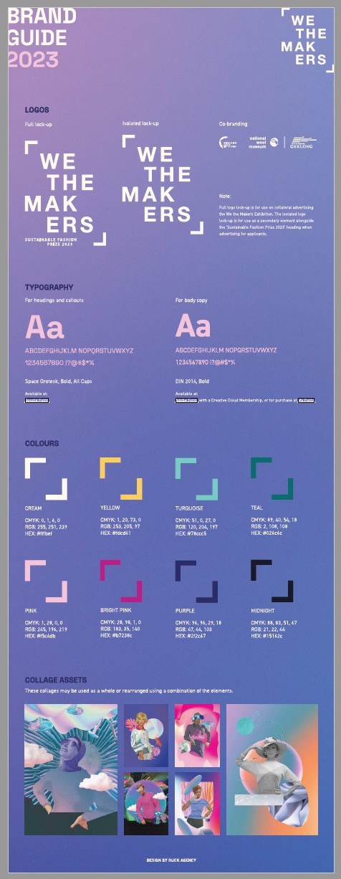
EXHIBITION
PREPARATION
Ruck Design Agency produced entire Brand Guide
Used for subsequent advertisements, exhibition design, label text
Every choice intentional: Mushrooms are major feature in design
Mushrooms and pineapples are a natural way of dying textiles = emphasise sustainable
Incorporate models from the NWM collection of vintage knitting pattern books
Communicate links between old wool fashion industry and our modern designers
Art elements are used to communicate messages and feelings
Nostalgic but bright colours
Natural mushroom-like forms and shapes
Mushroom and wool textures

Slide 13
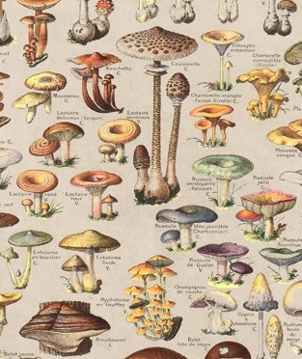
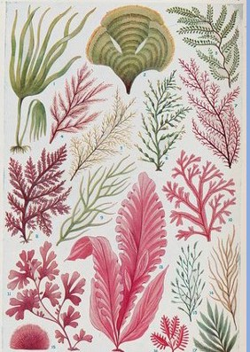
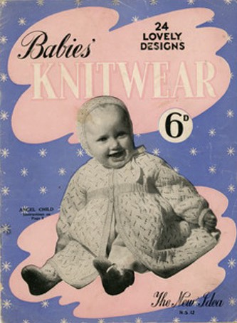
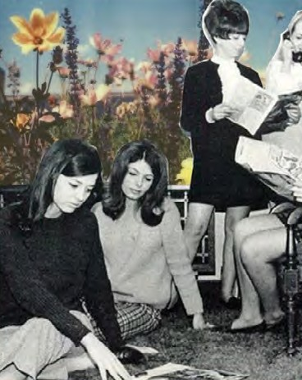
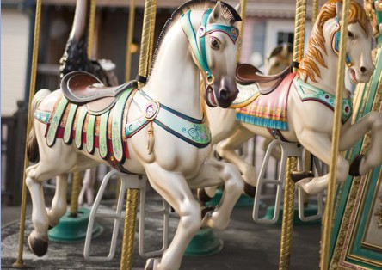
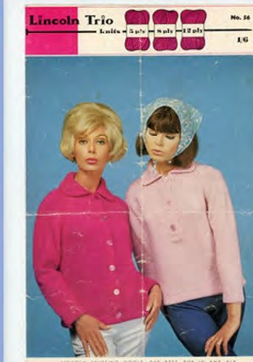
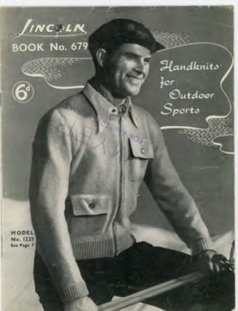
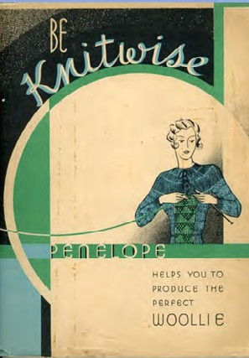
WHAT WOULD YOU DO…..?
ACTIVITY
If you were part of Ruck Agencies
– what images would guide you in creating a brand guide?
What colour palette would you choose? How many?
How would your branding communicate the sustainable ethics underpinning the ‘We The Makers’ exhibition?

Slide 14
CURATING AN
EXHIBITION
Curator Josephine Rout
Top 20 designs selected by curator from 77 entries
Designs needed to demonstrate one of the four themes:
Material Innovation
Business innovation
Circular process innovation
Design innovation
Strength of example and innovation helped designs to stand out and be selected
Exhibition had a very short preparation time: design entries closed on 16th April and the exhibition opened on 1st June
Curator research is captured in labels and exhibition catalogue

Slide 15
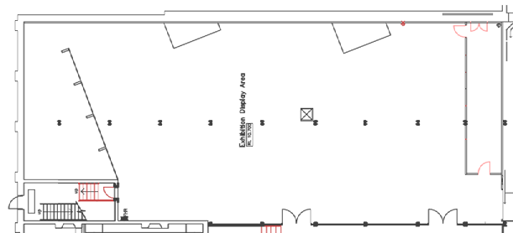
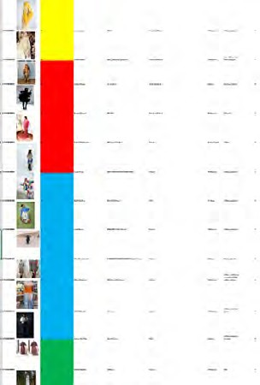
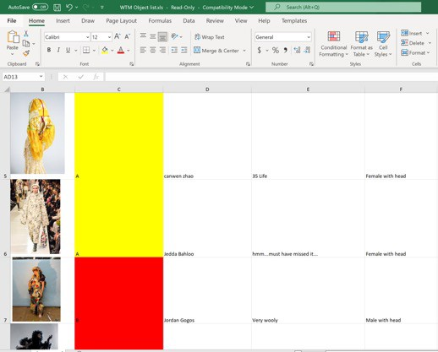
CURATING AN
EXHIBITION
Artworks were broken up into their representative themes
Material Innovation
Business innovation
Circular process innovation
Design innovation
A design could encompass a number of different themes but a predominant theme one was used to locate it within the gallery
Colour coding was used to guide install and groupings of designs
ON–SITE FOCUS
Can you guess which part of the room has the Material Innovation garments displayed together?

Slide 16
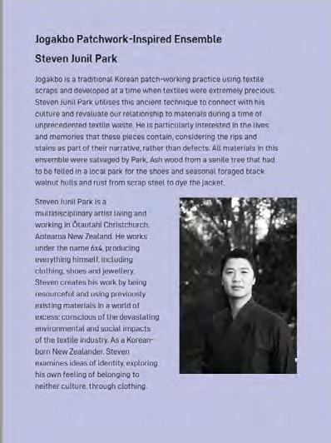
CURATING AN
EXHIBITION
LABELS
Balance of providing enough information but not so much people will feel overwhelmed
150 - 200 word limit
Same information is captured on We The Makers website = wider accessibility We The Makers website artist page
Display of text – Size and font guided by Brand Guide
Art elements: colour, form, line, shape, space, texture, and value
ON–SITE FOCUS
Choose a design and inspect the label. Does it provide enough information?
Can you see any support for people who vision impaired?
Which one do you prefer? Online or hardcopy? Why?
Image: Hardcopy label and website example for Jogakbo Patchwork-Inspired Example by Steven Junil Park

Slide 17
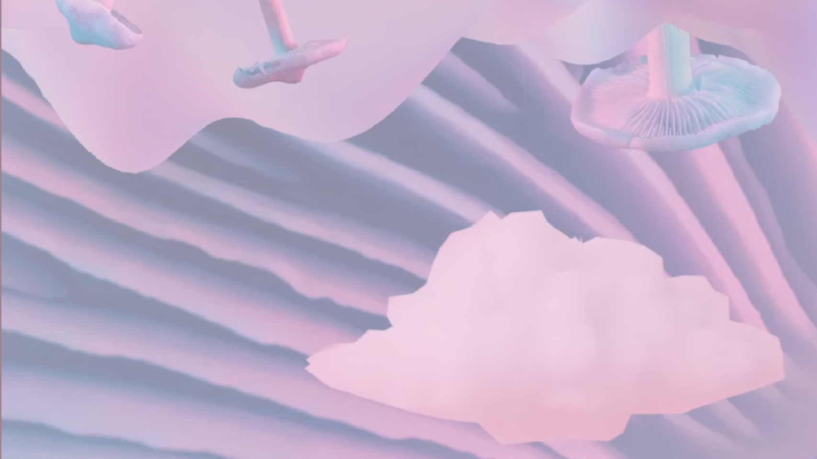
{ Didatic label (printed text)
{ QRF code (link to online website label)
{ Displayed in large glass case
{ Displayed Open display
{ Bollards
{ Plinth
{ Neighbouring digital display: interview with artist
{ Neighbouring Digital display: moving model wearing outfit
{ General digital display – exhibition clip showing models wearing ALL design entries
{ General Digital display – allows searching of website and designer labels
{ Individual visitor digital guides - containing interview audio and text on design outfits)
{ Individual static guides – pamphlet with label text on design outfits
{ Garment lying flat
{ Displayed on mannequin
ACTIVITY
You are given charge of styling the mannequin showing Slot Dress Prototype by Alixja Kuzmycz
Activity: Tick what display techniques and supports you would use to curate this design
Will it be affordable for the budget?

Slide 18
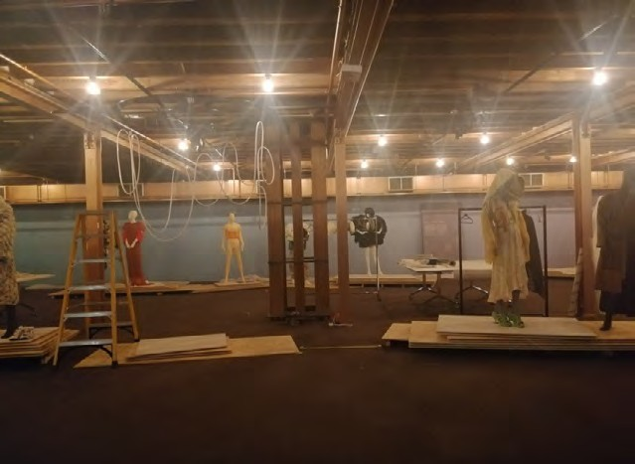
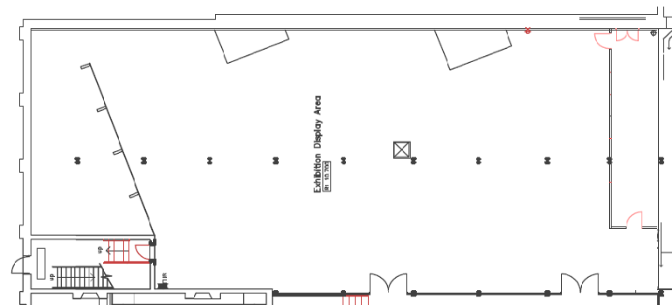
CURATING AN
EXHIBITION
GALLERY SPACE
ON–SITE FOCUS
Which garment catches your eye when you walk into the room?
Where is it positioned?
Do you think its placement in the room layout was intentional?
Do you feel distanced from the mannequins? What structures achieve this?
What way is the crowd moving? Does the design encourage crowd direction?
What is the ambience of the space?
Display options are controlled by space and funding
Designs/artwork positioning = direct movement of visitors through a space
We The Makers exhibition is located on Ground floor Gallery
Mannequins raised slightly on wooden runway & plinths
Open display approach (no cases or bollards) enables closer inspection of pieces

Slide 19
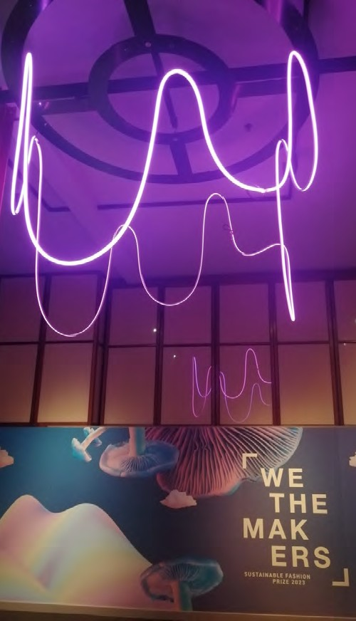
CURATING AN
EXHIBITION
ON–SITE FOCUS
What colour are the walls? What type of lighting is used? Is it dark or light in the space?
How is the information presented?
Are garments under glass, open display, behind bollards?
Are there ‘no touch’ signs?
Are there internal walls or an open studio approach?
EXHIBITION DESIGNING
Not just the mannequins and design entries in the Gallery
Design elements chosen specifically, guided by Brand Design Guide
Aesthetic = colours, materials, mannequin types
Art Principles: balance, emphasis, harmony, harmony, movement, pattern, proportion, repetition, rhythm, unity, and variety
Structural = plinths, artwork installations

Slide 20
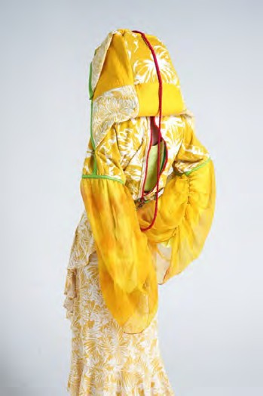
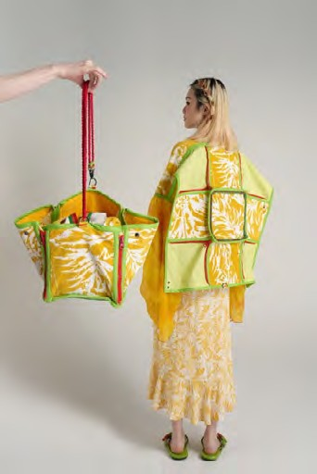
ACTIVITY
Out of the two options how would you display 35 Life? How would you display the bag set-up?
Consider how your curation will impact the visitors’ experience of the work and wider gallery space?

Slide 21
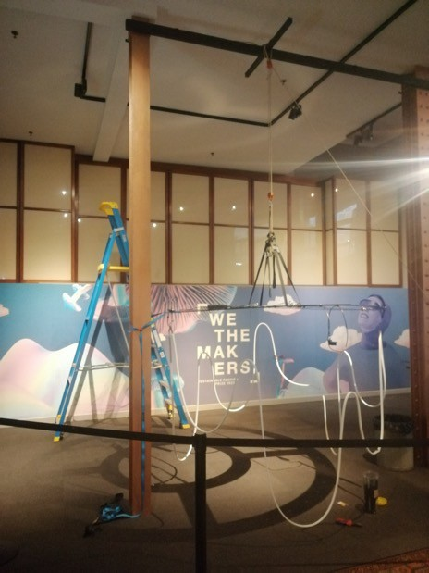
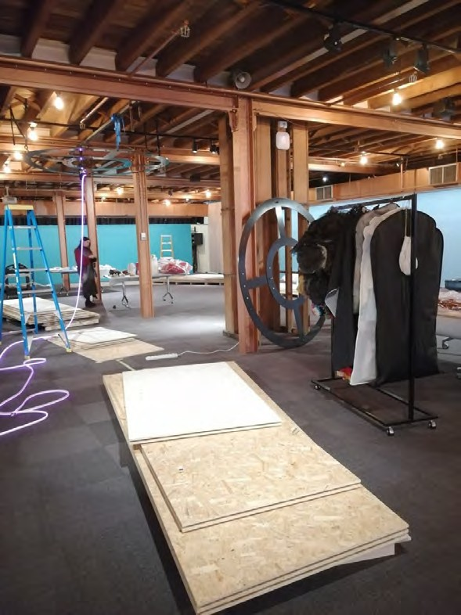
INSTALLING AN
EXHIBITION
STEPS TO INSTALLING ‘WE THE MAKERS’
Process called ‘Bumping in’
Positioning of plinths
Assembly of mannequins
Designs matched with mannequins and dressed
Labels are mounted
Lighting checked and evaluated
Lighting installation installed in foyer and exhibition space
Art Principles: balance, emphasis, harmony.
Image: Foyer mid installation
Image: Gallery mid installation

Slide 22
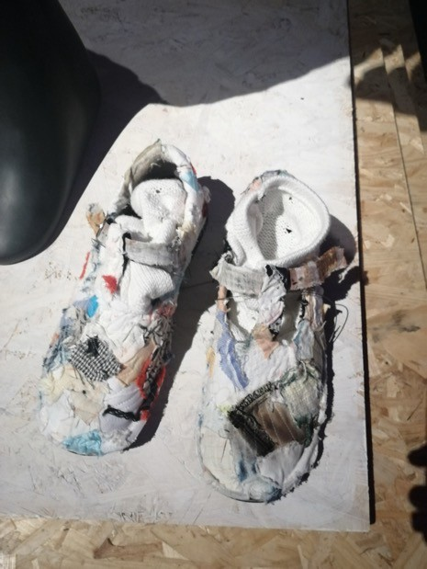
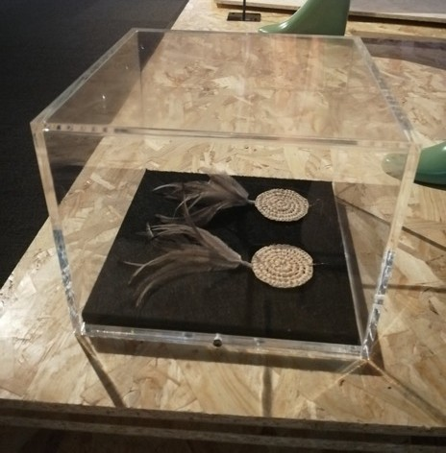
HOW
WOULD YOU INSTALL…
ACTIVITY
As well as curation and conservation
– security is a consideration during installation of an exhibition.
Activity: Below are two examples of garment accessories that are at risk of being taken... How would you display these items to balance security and curation factors?
Image: Shoes from ‘Hmmm Must have missed it by Jedda Bahloo
Image: Earrings from Kaweerr Koorran Dres by Jasmine-Skye Marinoa

Slide 23
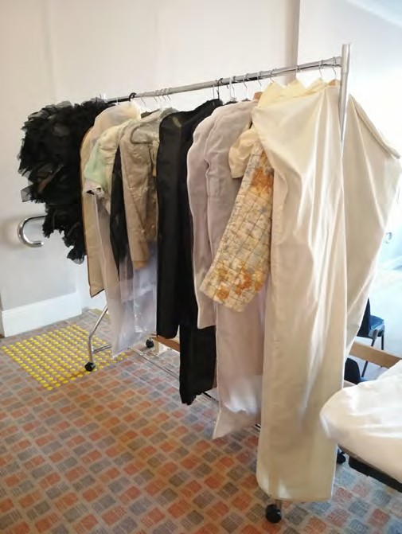
CONSER- VATION
PRE-EXHIBITION:
Quarantine new arrivals – all garments are on loan
Condition reporting of designs
Custom supports planned and provided for fragile designs
Providing advice concerning risks of proposed displays and public access
ON–SITE FOCUS
Textiles are renowned for being light sensitive. Consider the lighting – do you think it has been lowered to safe guard the materials or is it to suit human eye-sight?
Image: Entries waiting for condition reporting

Slide 24
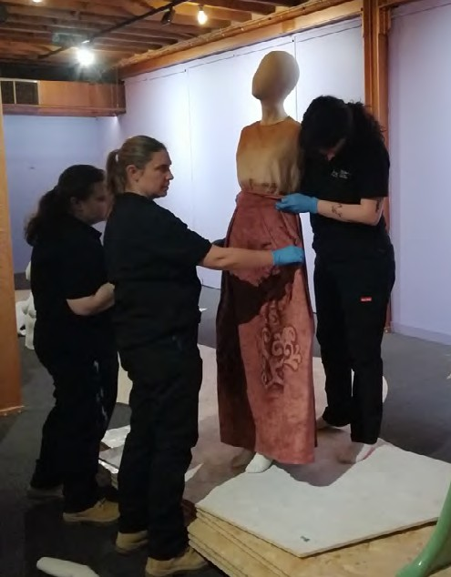
CONSER- VATION
DURING EXHIBITION:
ON–SITE FOCUS
Can you spot the archival material called ‘Mylar’ protecting textiles that touch the floor?
Do you think this transparent barrier impacts people’s interpretation of the garments?
Handling garments during install
Creating exhibition supports and barriers to protect textiles
Monitoring and recording lighting exposure
Monitoring and recording of environmental conditions in gallery space
Monitoring for insect presence
Image: Luci, Emma and Emily dressing mannequin for Folklore by Ruth Hadinjoto

Slide 25
CONSER- VATION
POST-EXHIBITION
De-instal garments from gallery space
Condition Report completed – comparison against original report
Packing and safe storage of textiles for return to owners
Formal accessioning of competition finalist into NWM collection
ON–SITE FOCUS
Looking at the textiles present… which material will Collection Officers need to look at carefully for signs of damage at the end of the show?
Image: Josephine (curator) and Luci (Collections) installing design Re-weave by Lilli McKenzie

Slide 26
CONSER- VATION
RELATIVE HUMIDITY (RH)
Ideal: 50% (+/- 10 degrees)
Risk: Sudden changes in temperature or RH can cause stress
TEMPERATURE
Ideal: 20 C (+/- 2 degrees) temperature
Risk: High temperatures can increase material damage and risk of insects
INSECTS
Risk: Natural Fibres like wool are targeted by insects like moths. Fibres damaged and eaten. Infestation endanger other collection items
Conditions are monitored and recorded
Keep conditions are stable as possible
Temperatures are monitored and recorded
Monitor for insects using sticky traps
Annual check of garments looking for signs of damage or insect frass
Building is kept clean
If infestation suspected – garment placed in freezer to kill insects
LIGHTING
Ideal: 50 Lux (lighting) for sensitive materials
Risk: Textiles’ colour irreversibly faded, fibres weakened
TRANSPORT AND STORAGE
Risk: Textile are stressed along seamlines causing damage
Designs are either hung on padded coat-hangars
Fragile items stored flat in archival card boxes
Transported on trolleys and clothes racks to reduce handling
Lighting lux levels are kept low
LED globes only (removes UV and heat)
Lights are turned kept off out of exhibition opening hours
Direct lighting is avoided on sensitive materials (recommend less than 50 lux)

Slide 27
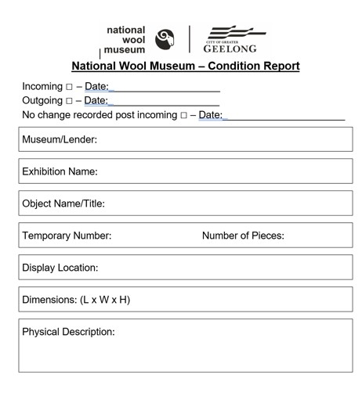
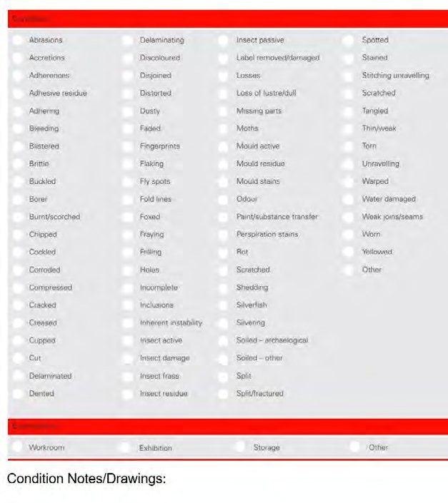
CONSER- VATION
CONDITION REPORTS
Documentation to show how an item is faring
Allows contrast over months or years to show changes
Condition reports completed on all garments on their arrival and again before they are returned
Image: Examples of condition report formats filled out by Collection team

Slide 28
CONSER- VATION
ACTIVITY
Choose a design in the We The Makers gallery
Study its closely looking for deterioration and risks.
Conduct a simple Condition Report
{ Abrasions
{ Accretions (imbedded foreign object)
{ Adherences (things stuck to it)
{ Adhering
{ Bleeding
{ Blistered
{ Brittle
{ Buckled
{ Borer
{ Burnt/scorched
{ Chipped
{ Cockled
{ Corroded
{ Compressed
{ Cracked
{ Creased
{ Cupped
{ Cut
{ Delaminated (layers separating)
{ Dented
{ Discoloured
{ Disjoined
{ Dusty
{ Faded
{ Fingerprints
{ | Flaking | { | Rot
{ | Fly spots | { | Scratched
{ | Fold lines | { | Shedding
{ | Foxed (orange spotting) | { | Silverfish
{ | Fraying | { | Silvering
{ | Filling | { | Soiled –archaeological
{ | Holes | { | Soiled – other
{ | Incomplete | { | Split
{ | Inclusions | { | Spotted
{ | Inherent instability | { | Stained
{ | Insect – active | { | Stitching unravelling
{ | Insect damage | { | Scratched
{ | Insect frass | { | Tangled
{ | Insect residue | { | Thin/weak
{ | Insect – past | { | Torn
{ | Label removed/damaged | { | Unravelling
{ | Losses | { | Warped
{ | Loss of lustre/dull | { | Water damaged
{ | Missing parts | { | Weak joins/seams
{ | Moths | { | Worn
{ | Mould active | { | Yellowed
{ | Mould residue | { | Other
{ | Mould stains
{ | Odour
{ | Paint/Substrate
{ | Perspirations stains
MATERIALS TYPES YOU CAN SEE:
GENERAL CONDITION:
{ Appears stable
{ Active deterioration noted
{ Damaged noted
{ Fragile/weak
RECOMMENDATIONS:
{ Make tailored supports
{ Diffused lighting to reduce exposure
{ UV filter on lighting
{ Insect monitoring trap
{ Dessicant (used to remove moisture)
{ Freezing (used in insect or mould infestation)
{ Recommend treatment by specialist conservator

